Slide 1
Course : Computational Physics
Effective Period : April 2022
Simulating Basic Rectifier Circuits Session 4

Slide 2
Objective and Outline
LO : Implement a computational simulation of basic electrical circuits using Python programming language
In this course we will be simulating power electronic circuits using Python. However, the Python part is not heavy. This course is ideal for students only with a basic knowledge of network theory and programming to get started with simulating simple power electronic circuits. The course contains a basic introduction to the Python Power Electronic (PPE) and describes how to use it to simulate simple rectifier (RLC) circuits.
In this session, we will start exploring a simulation concept using Open-Source Python Power Electronics
Download : https://www.pythonpowerelectronics.com/
Outline
Introduction to Rectification Concept
Design and simulating Rectifier Simulation
Analysis of basic Rectifier output graph

Slide 3
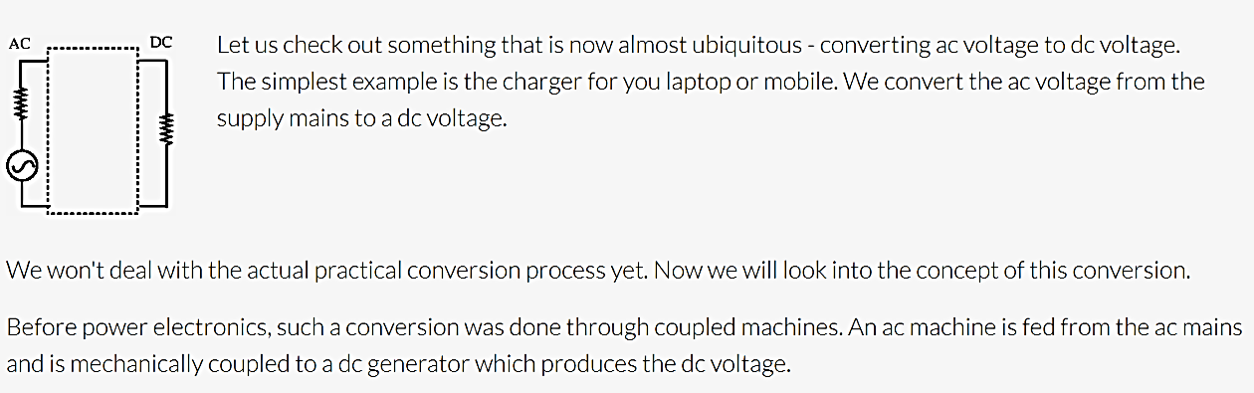
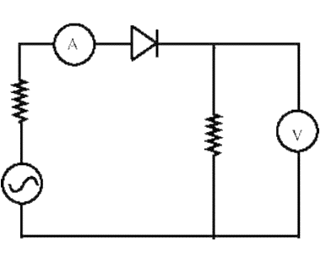
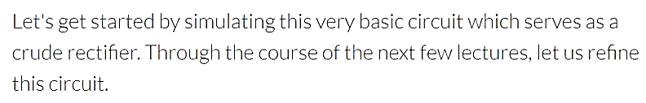
Rectification Concept

Slide 4
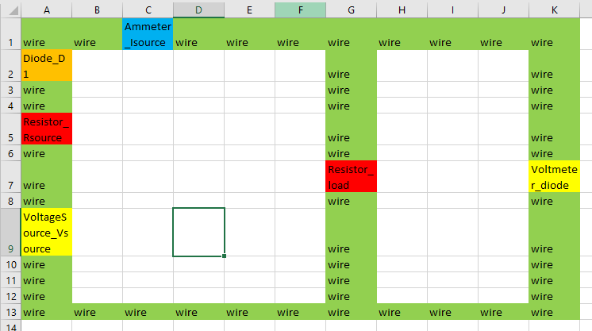
Simulating Basic Rectifier Circuits
Open MS Excel and recreate the circuit design
Rules: ComponentType_ComponentName and its case sensitive.
Save in basic .CSV file → e.g D:\...\simulations\single_diode_rectifier_.csv (this is your WORKING DIRECTORY)
Webserver launch reminder!
Activate ppe environment
Go to manage.py folder directory (launch file)
If the structured database is already created, run the webserver by python manage.py runserver
Copy http://127.0.0.1:8000/ (or other URL) and run in your browser
Creating simulation
Run the PPE webserver
Create new simulation ‘Single Diode Rectifier’, add your working directory file.
Solve the warning if there is any, save first, and you can edit later when you need it.

Slide 5
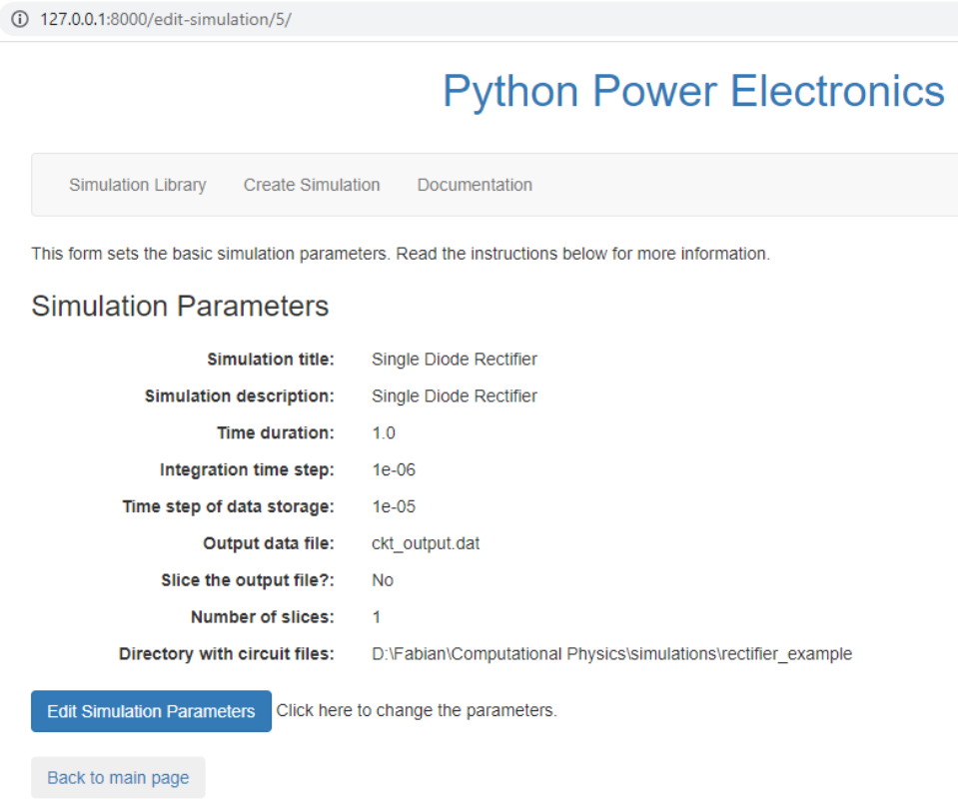
The smaller the integration time, the higher the sampling frequency. But longer processing time. The larger the faster, but you lose some data record

Slide 6

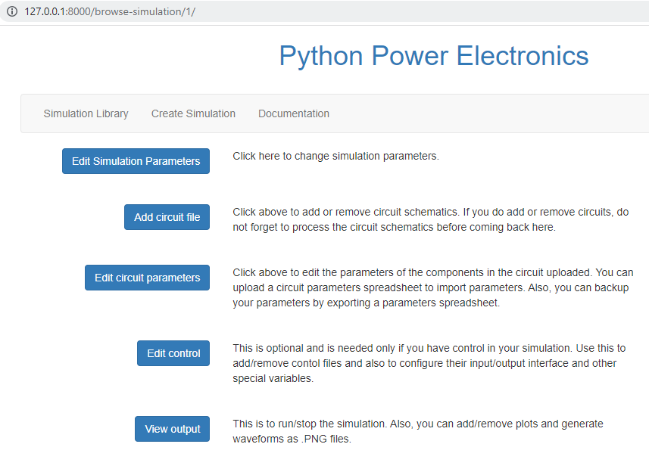
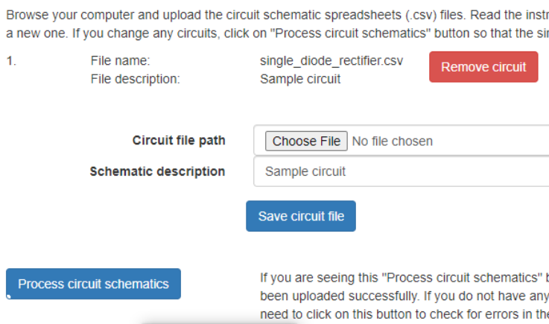
Adding minimalistic circuit simulation
Check is the testfile is created in the WORKING FOLDER
Open and understand the .CSV file structure using word editor
Go to Simulation Library → Load the Rectifier Simulation → Back to Main Page
Add circuit file → select file → safe circuit file → process circuit schematic
If error, update the .CSV file → process circuit schematic. No need to reupload
Then → Back to main page

Slide 7
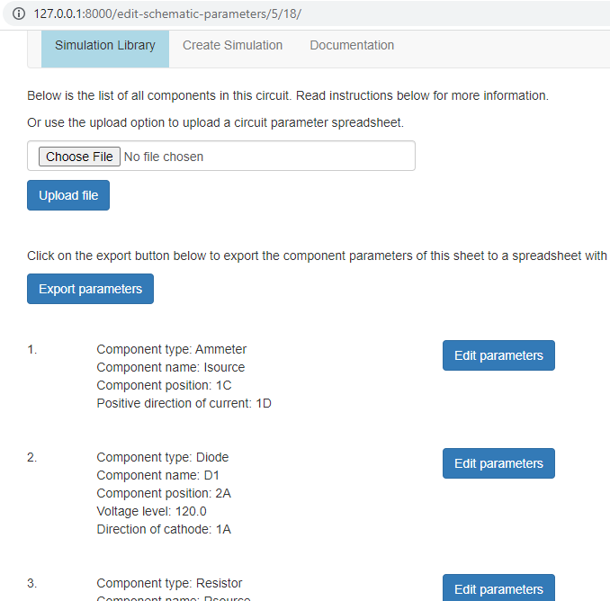
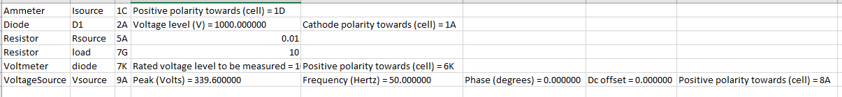
Simulating Basic Rectifier Circuits
Edit Circuit Parameter
Click Edit circuit parameter → Edit parameter and change according to the parameter here.
We tried to simulate the numbers and component behaviour
The Parasitic Resistor should be negligible

Slide 8
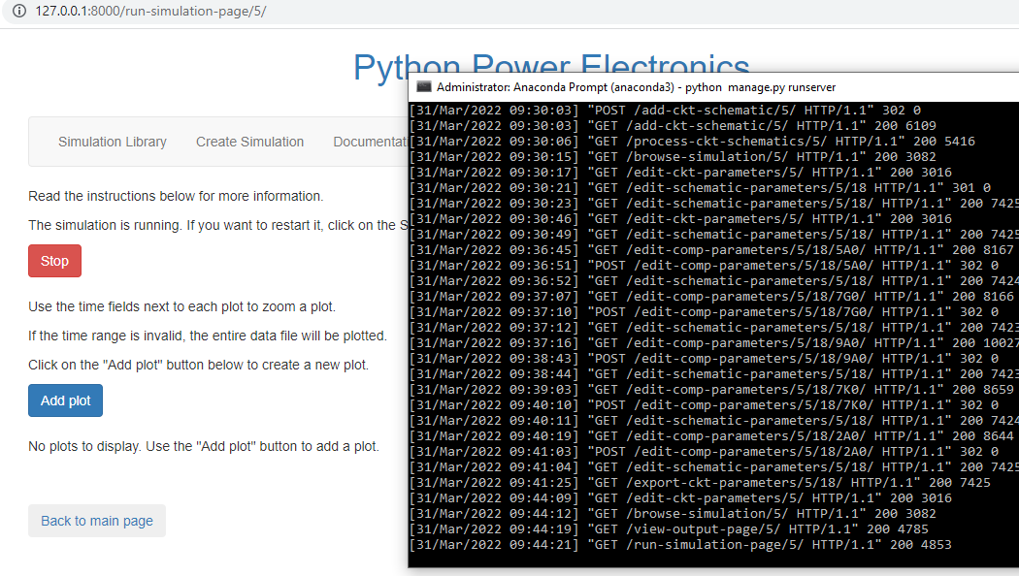
Simulating Basic Rectifier Circuits
Run Simulation
Go back to the main menu → Click View output
Check if there is any error on the anaconda prompt
Run the simulation → add Plot

Slide 9
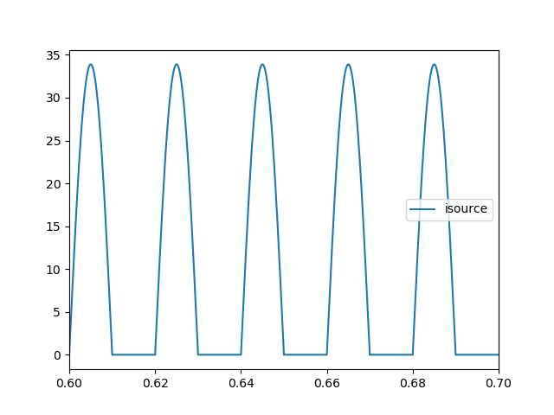
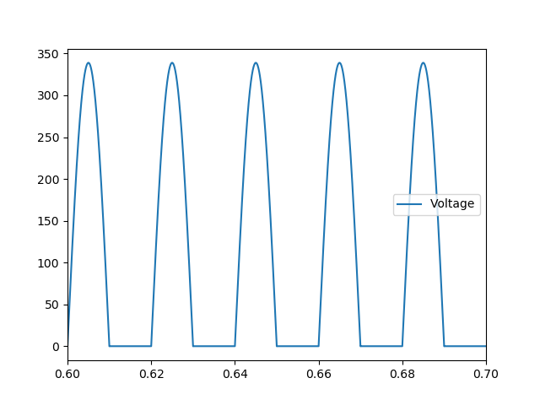
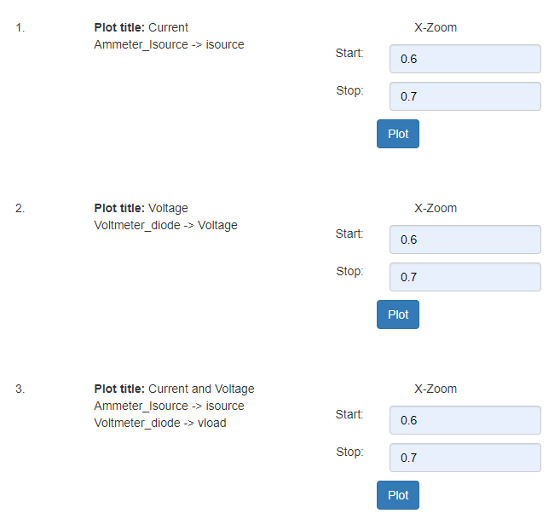
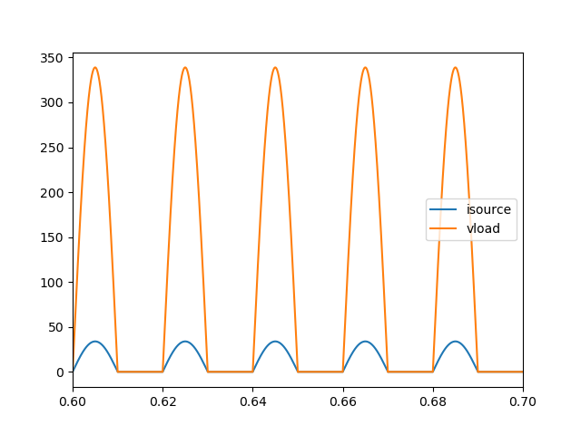
Simulating Basic Rectifier Circuits
Plot Simulation
Add Plot → follow the setup → Plot and see the Graph
Output Graph Analysis
The function of diode is to limit half of the cycle.
When drawing a current
No load at the half cycle
Average of all cycle is not zero, but positive value → net positive value on the device

Slide 10
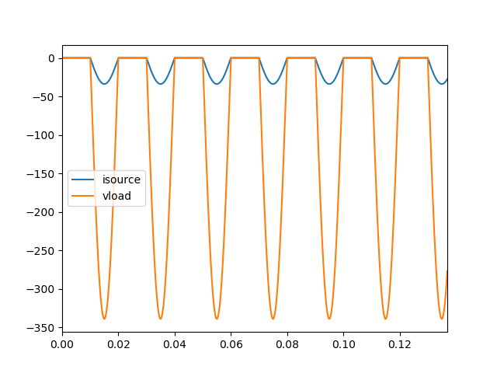
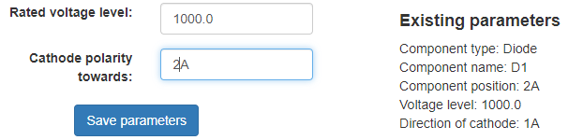
Redraw the Simulation
Stop the simulation →Go to the main page → Edit circuit parameters
View components → Edit the Diode parameter
Change the cathode polarity to it’s reverse direction
Sae Parameters → Go back to the Output → Plot the sama graph and compare
The output graph shows how the diode act as reverse bias on the positive half cycle and reverse bias during the negative half cycle.
The output graph show the reversed biased diode effects on the voltage and current draw. The result is converted because Cathode is connected to positive terminal of the V source.

Slide 11
Can we use this as a DC source to supply computer that requires a steady 9 Volt DC ? Not yet!
Discussion
Congratulations! We are able to create net positive voltage and current using a diode. Can you explain what is the function of Diode? And which one do we need? The forward or reversed biased Diode?
However, in half cycle, the load is very high and almost zero in another half cycle. this is very unstable and will hurt our devices, since our device needs a steady.
We will add another component on the next class. Can you guess what is it and what is the function of that component?

